Slide 1


FLEXBOX Adrien Houen

Slide 2

Once upon a time …
Date : 23 July 2009
Native name : CSS Flexible Box Layout
Abbreviation : Flexbox
Responsive elements
Responsive elements for the growing variety of screen sizes
98,69% of installed browsers support Flexbox

Slide 3
Introduction to Flexbox Layout
Align items
Distribute space among items
To give the container the ability to alter its items’ to best fill the available space
Flexbox layout is appropriate for small-scale layouts

Slide 4
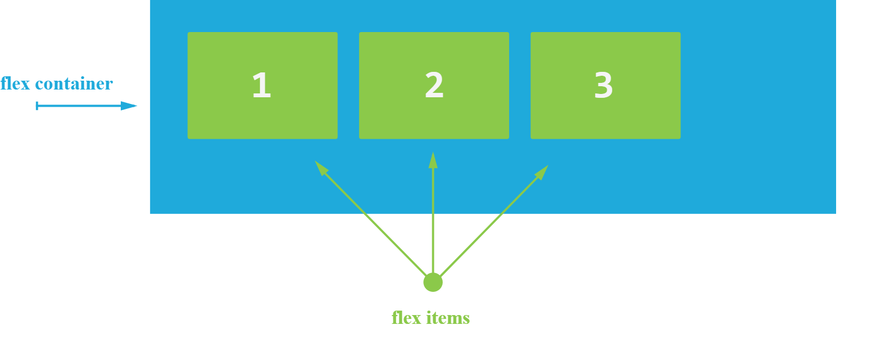
Basic

Slide 5
Flexbox properties
Properties for the Parent
(flex container)
Properties for the Children
(flex items)
display
flex-direction
flex-wrap
flex-flow
justify-content
align-items
align-content
order
flex-grow
flex-shrink
flex-basis
flex
align-self

Slide 6
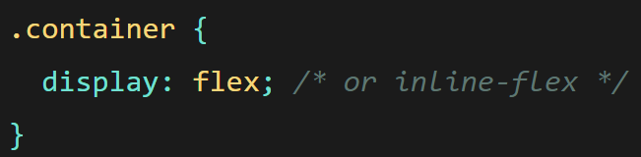
display
Transform HTML element into a flex container

Slide 7
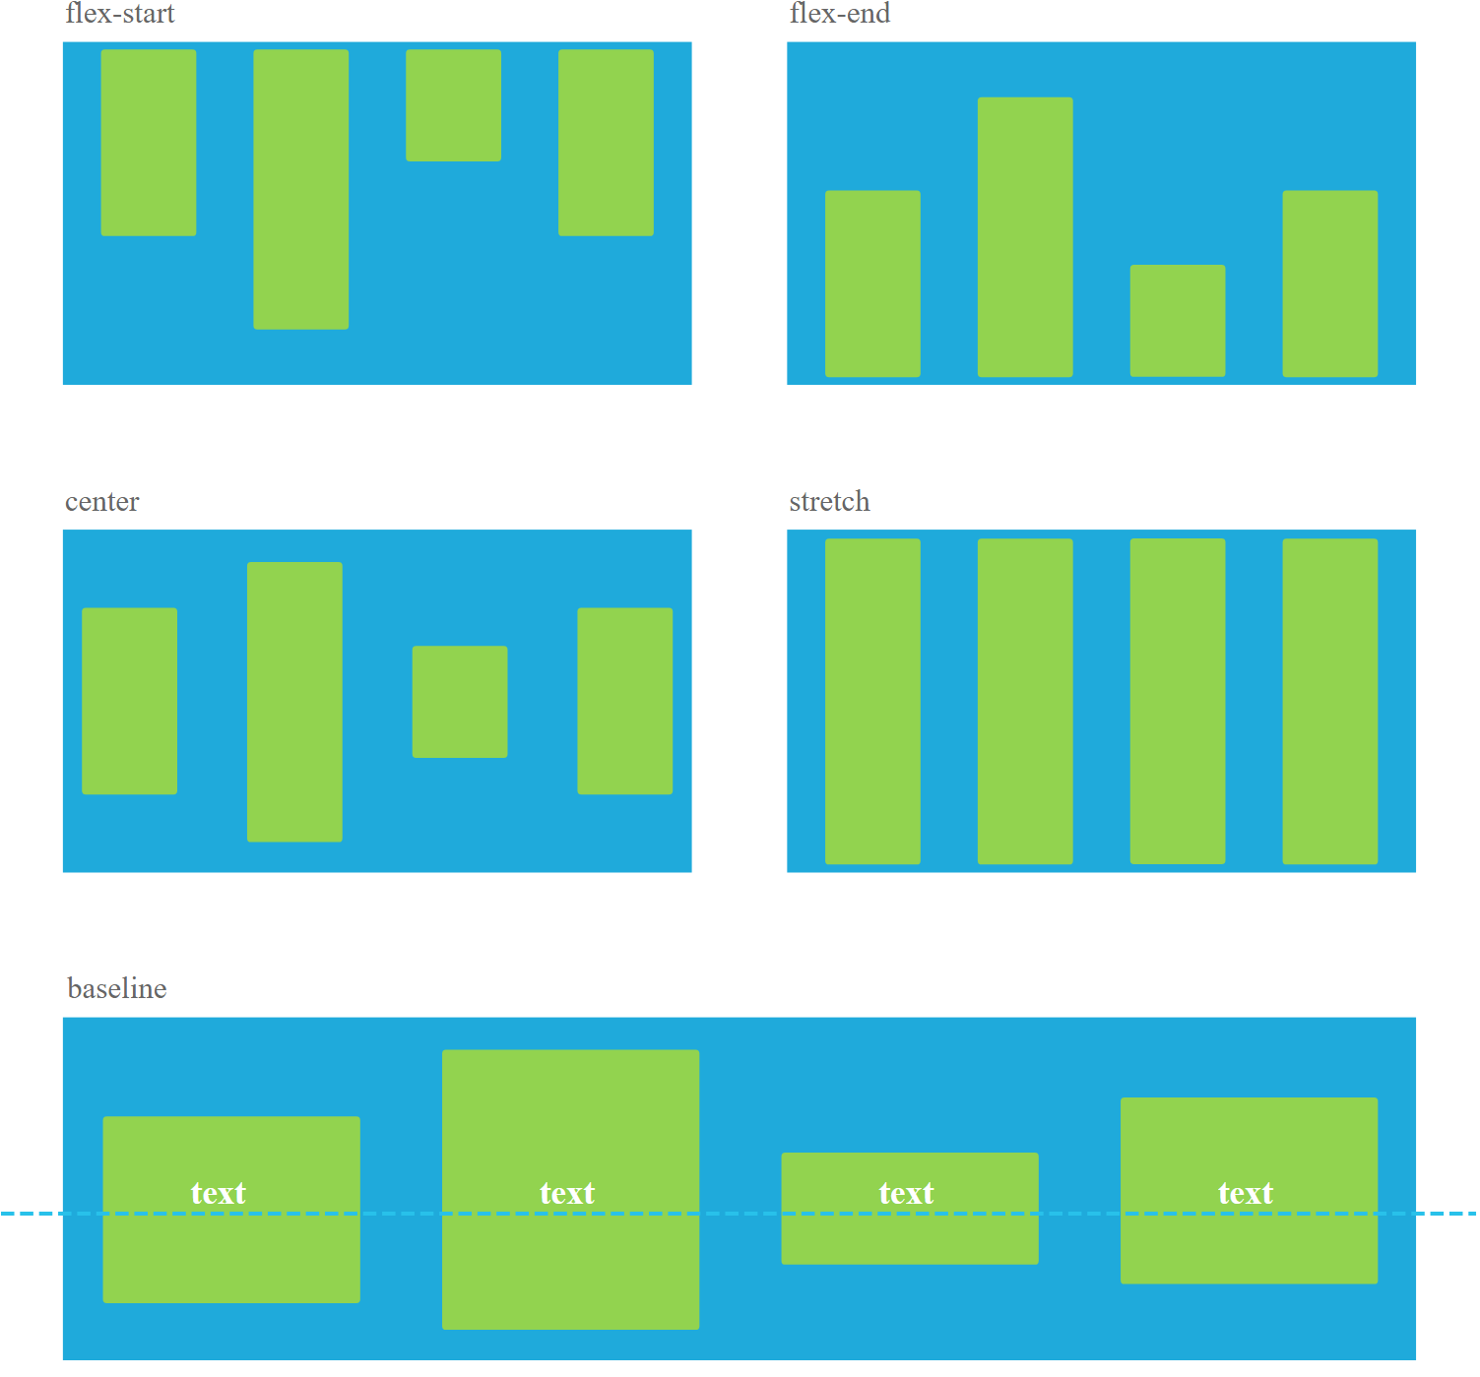
align-items
stretch (default)
flex-start / start / self-start
flex-end / end / self-end
center
baseline

Slide 8
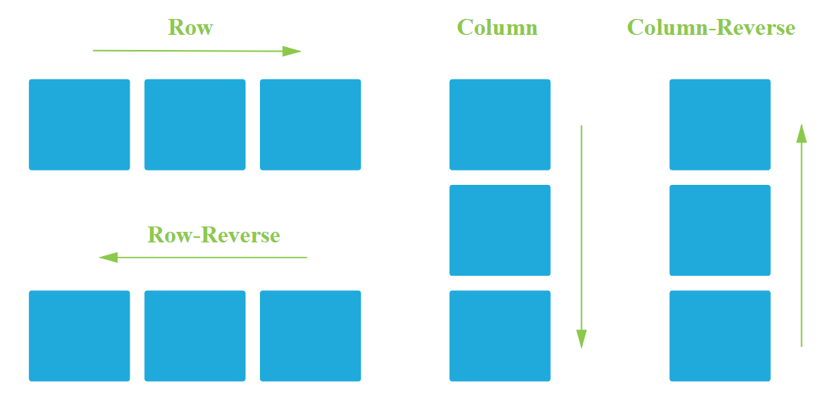
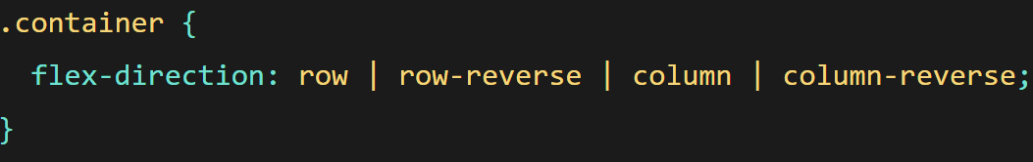
flex-direction
row (default)
row-reverse
column
column-reverse

Slide 9
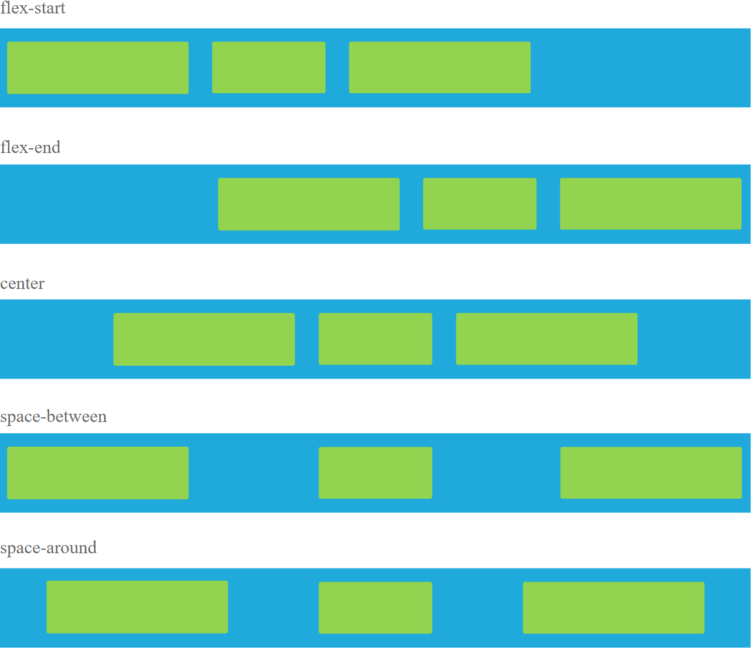
justify-content
flex-start (default)
flex-end
center
space-between
space-around
space-evenly

Slide 10
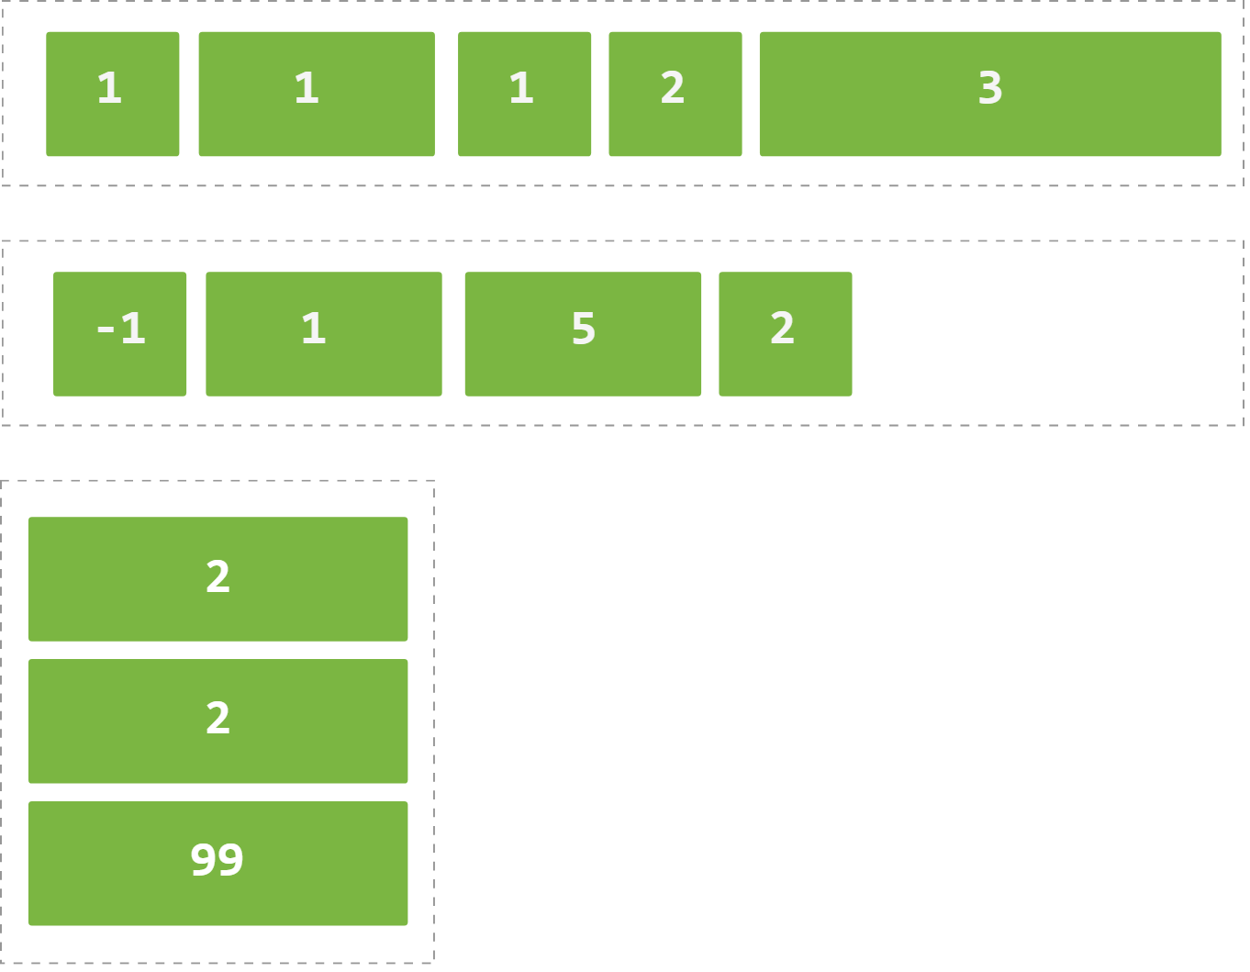
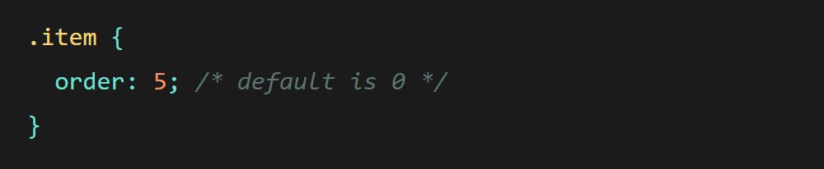
order
Default value is 0
Order by default : From lowest number to the highest
The order property change the order by default

Slide 11
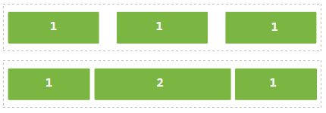



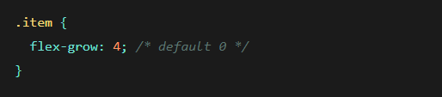
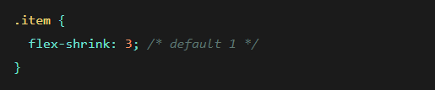
flex-grow / flex-shrink

Slide 12


Let’s pratice ☺

